Slide 1
Essence Member Website
Everything members need…at their fingertips!
*Sign up with unique email address or Google account*

Slide 2
No Need to Call!
On www.EverythingEssence.com , you can:
Check medical claims, referrals, and prior auths
View, print, or request a copy of your Member ID card
Opt into paperless communications
Update your member profile so we have the most current email, cell phone, and more
Download most forms and documents (more on slide 4)
Find in-network providers
Change your PCP (HMO only)
PPO members can call Customer Service to tell us their PCP.

Slide 3
Access Vendor Sites!
No additional password needed for:
Flex Card Benefit: WEX Consumer Portal
View account balance, transactions, participating merchants
Express Scripts Website
View pharmacy claims
Create an account on:
Direct Biller (but can make one-time payments as a guest)
DentaQuest
EyeQuest
Instructions to download and use the Essence Flex Spend Mobile App

Slide 4
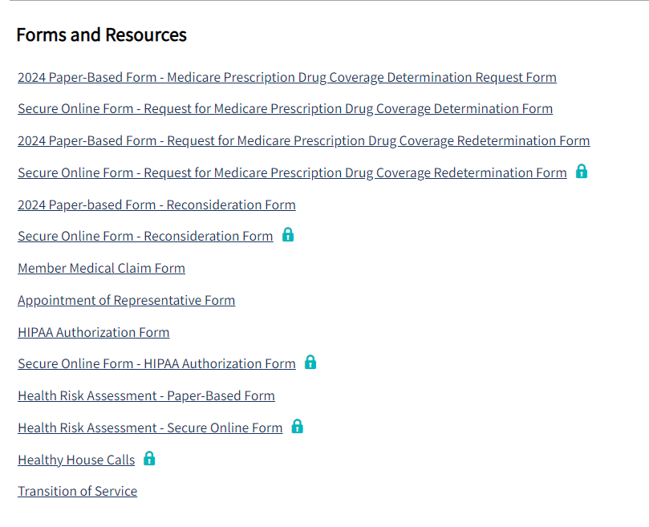
Find Most Forms and Documents!
Download or submit online
Payment Option Forms
Coverage Determinations / Redeterminations (Part D)
Health Risk Assessment Forms
HIPAA Authorization Forms
Download or print
EOC, ANOC, Provider Directory, and Drug Formulary
Appointment of Representative Form
Member Medical Claim Form

